Slide 1
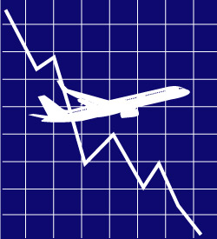
Assignment 2: Airline Bankruptcy
Date: Tuesday, December 4, 2012
Team 4: Colin Boddy, Krista Alec, Patrick Twinn, Hana Matsui & Jake Lynch
Professor Mahesh Kumar
Royal Roads University
Notes:
Good Morning fellow Students and Professor Kumar. We are Team Four “Dances with Cougars”, and today we will be speaking to you about the bankruptcies that have plagued the airline industry, specifically in the past decade. We will be taking you through some of the significant instances of airline bankruptcy in the first decade of the 21st century, the impacts that these bankruptcies have had on their stakeholders and the economy in general, and the key factors cause Airlines to not be able to meet their financial obligations, specifically: the industries reliance on oil, poor labour relations and high labour cost, & poor service management. We will also discuss ways that Airlines can respond to these factors to maintain a health financial position, and present Emirates Airlines as the industry best practice before concluding and taking your questions.

Slide 2
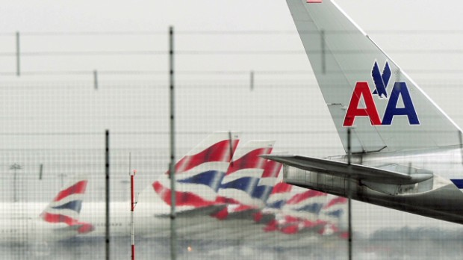
The Decade of Airline Bankruptcy
"If a capitalist had been present at Kitty Hawk back in the early 1900s, he should have shot Orville Wright”.
- Warren Buffet, 2002
There were over 20 Airline Bankruptcy filings between 2000-2010. Notable ones included:
American Airlines (2012) - $24.7 Billion
United Airlines (2002) - $22.8 Billion
Delta Airlines (2005) - $21.6 Billion
Northwest Airlines (2005) - $$14.4 Billion
US Airways (2005) - $8.6 Billion
Japan Airlines (2010) – $25 Billion
Air Canada (2003) (2009) – Granted Bankruptcy protection by Government of Canada
Notes:
All Bankruptcy facts above from (Dempsey, 2012)
There were 20 Airline Bankruptcies between 2000-2010 (Tolkien, 2010,p.3)
Since September 11, 2011 the industry has lost $53.4 Billion in net profit (Tolkien, 2010, p. 5)
“The Airline industry is structurally challenged in its very nature, facing high fixed costs, cyclical demand, intense competition, and vulnerability to external shocks”. (Tolkien, 2010, p.5). As travel and tourism is a purely leisure activity, air travel is heavily elastic, and has been devastated by the financial crisis.
The inability to meet debts is the ultimate motivator for Airlines to enter Chapter 11 Bankruptcy, which offers firms protection from creditors. Most of these airlines emerge from Chapter 11 Bankruptcy and resume operations after raising capital from investors, restructuring costs (layoffs, corporate restructuring, etc) or government bailouts because the service as seen as “essential” to the country or “too big to fail” (see: Air Canada).
However, some airlines are unable to emerge from Ch. 11 Bankruptcy, and have to enter Ch 7 Bankruptcy, forcing the firm into liquidation, ending its service. This was the case for Pan Am Airlines, Trans World Airlines (TWA), and Eastern Airlines. (Tolkien, 2010, p.6)
Now I will turn over the floor to my colleague Hana Matsui to discuss the implications of and reasons for airline bankruptcy.

Slide 3
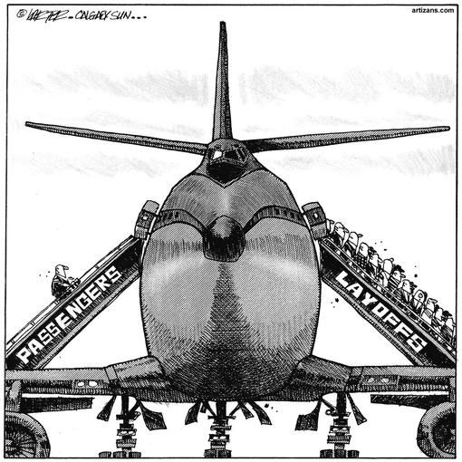
Impacts of Airline bankruptcy
“This is a dirty, rotten business”
- Bob Crandall, former President of American Airlines
A decline in travel & tourism: destinations affected
Employee Layoffs
Government Bailout Spending
Negative Economic Impacts
Notes:
Thank you, Jake.
Air travel and tourism are intrinsically interlinked (Bieger, Wittmer, 2006). When airlines enter bankruptcy, their flights stop. This grounds travelers seeking to visit a specific destination. Therefore, bankruptcy of airlines will limit the success of the destination. If the bankruptcy is prolonged and the destination is depending solely on the airline as the primary carrier, this can drastically impact the destinations economic benefit from tourism (WTO, 2009).
Airline bankruptcy causes employee layoffs and increases the overall unemployment rate. Airlines entering Ch. 11 bankruptcy typically cut costs by eliminating labor. An example of this is Japan Airlines, who cut 15,600 jobs while in their bankruptcy stage (BBC, 2010). This is typical of firms when in this stage.
Another impact is increased government bailout spending. In 2001, then President George W. Bush bailed out the American Airline Industry to the tune of $18.6 Billion in part to compensate for the mandatory groundings they experienced because of the 9/11 terrorist attacks (Nankin, Schmidt, 2009). Similarly, the government of Canada loaned Air Canada $250 mil out of a total $1 billion lent to the company in 2009 to help them avoid another trip through bankruptcy protection (Jang, 2009).
Bankruptcy of a major company always takes a major toll on the economy. Significant layoffs will cause a higher unemployment rate, causing less consumer disposable income in the community which will hurt all businesses, especially non-essential businesses such as travel and tourism. This perpetuates an economic vicious circle. Moreover, the creditor’s payment will be delayed, as will business that is dependent on traveling with the airline.

Slide 4
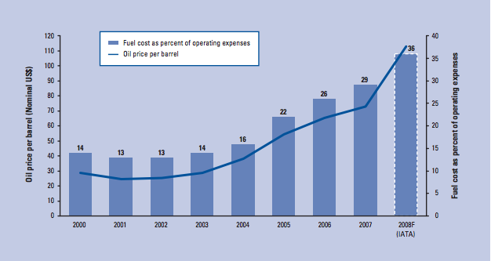
Oil
Airlines completely reliant on the commodity of fuel to operate
Profitability of Airlines at the mercy of current oil price/barrel
Higher fuel prices lead to price increases for consumers
Price of oil predicted to be as high as $203.90 by 2030
Notes:
So, what are the causes of airline bankruptcy? One cause could be oil cost.
This is because airline companies rely on the commodity of fuel to operate. “On average, fuel cost constitutes 20-30% of an airline’s operating costs, representing the second largest expense” (Tolkien, 2010, p.29). However, on long-flights it is regularly the largest expense, taking up to 50% of the airlines costs (WTO, 2009, p.41).
Also, profitability of airline companies depends on prices of oil. Oil prices are very volatile, and are affected by several factors such as interrupted refinery operations; environmental regulations; surges in regional demand; seasonal swings in demand; supply disruptions caused by natural disasters, military conflict or geopolitical events; and market speculation (Tolkien, 2010, p.29).
The bar chart shows changes in fuel cost as percent of operating expenses and the line chart shows changes in fuel costs per barrel. You can see that oil prices are gradually going up since 2002. As the price of oil continues to skyrocket, airlines have to increase their prices to accommodate for the increase to their operational costs (WTO, 2009). The increase in the cost of plane tickets will drastically reduce the affordability of consumer air travel and significantly reduce the number of tickets purchased. This is an extreme threat to the financial viability of airlines.
Unfortunately for airlines, the price of oil is only going to continue to rise due to increasing scarcity and the cost of inputs. Natural Resources Canada predicted that world will hit “peak-oil” production by the year 2030, which means crude oil could cost $203.90/Barrel (Natural Resources Canada, 2010). The price on November 22, 2012 was $ 87.38 (Oil-Price.net, 2012). So the price is predicted more than double in 28 years. Keeping relying on fuel in the same way will likely cause increasing airline bankruptcy for the foreseeable future due to a significant increase in oil prices.

Slide 5
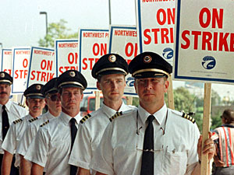
Labor relations
High Labor Cost
28% of American Airlines’ revenue
Higher costs means lower profit margin
Union
Half of airline companies in the U.S. are unionized
Seeking higher wages/better benefits
Strikes
Down-grade credit rate
Notes:
Another cause of airline bankruptcy is Labor Relations.
First of all, high labor cost threatens airline companies. An example of this is American airlines which filed for bankruptcy in 2012 as Jake mentioned. Labor cost of American airlines’ is 28 % of its revenue and this is the highest of any major airline in the U.S. today (Glassman, 2012, para8).
Higher labor costs increase operating costs, then it decreases profit margin. Therefore, higher labor costs increase the risk of bankruptcy.
The other problem regarding Labor Relations is unions. Labor unions play a critical role in the US airline industry. About half of all workers in the air transportation industry are unionized, 49.3% of workers being union members and 51.6% being covered by collective bargaining agreements in 2006 (IATA, 2007, p.1). Although airlines strive to cut costs in order to avoid bankruptcy, a union might not be happy about that. This is because the labor unions are seeking higher wages or better benefits, and these are causes of increase labor cost (Tolkin, 2010, P.40)
Also, unions constantly seek to renegotiate contracts and strike when their demands are not met (Tolkin, 2010, P.40). Once a strike happens, all operation would be stopped. It not only decreases productivity, but also decreases profitability due to unable to operate daily work.
Unions’ movements also affect investments for airline companies. Moody's Investor Service cut Air Canada's credit rating on April 3, 2012, after intentional move of buying time to reach an agreement and avert a threatened strike and lockout (“Air Canada’s,” 2012, para4).The move put the new rating at Caa1, down from B3 because there was an increased possibility the airline could default on its debt obligations (“Air Canada’s,” 2012, para4). The decrease in credit rating causes some investors to avoid making investments on airline companies which leads airline companies to have less capital for operation and financing. Less capital makes companies to finance its debt which can increase possibility of bankrupt.
Now, Patrick will be talking about another cause of airline bankruptcy, poor service management.

Slide 6
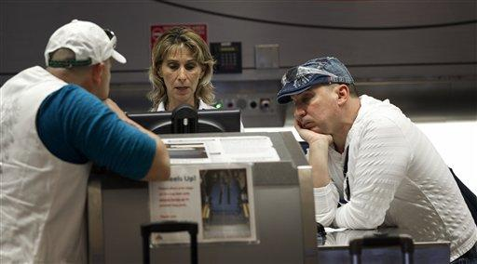
Poor service management
American Airlines scores poorly in CS & AQ surveys
Poor organizational culture among pilots, air crew, & ground crew
Exorbitant flight delays caused
Only 58% of flights arrive on time
Notes:
American Airlines has the lowest number of on-time arrivals within the United States, at 58%. Although weather is listed as the primary factor in delays, other factors within the airline’s control, such as maintenance and crew problems are currently listed the second most common factor in causing delayed flights. The primary causes to American Airline’s exorbitant delays are due to the lengthy drawn out negotiations with pilots and ground crew regarding contracts. The relationship between management and the labour unions are strained due to layoffs and pay cuts. American Airlines management has accused pilots of intentionally delaying flights by calling in sick or writing up last minute maintenance issues.

Slide 7
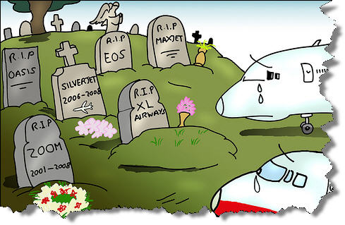
Ways to Avoid Bankruptcy
Reduce commodity (jet fuel) dependence
Implement strategic plan to increase customer service satisfaction
Utilize opportunities to reduce labor costs
Capitalize and expand to emerging market destinations
Notes:
In an effort to reduce long-term costs, American Airlines announced $38 billion order for 460 new single-aisle aircrafts as part of a major of their aging fleet that has an average age of 15 years (NY Times, 2011). Currently, American Airlines remains one of the oldest and least fuel efficient airlines among the six major US airlines. As a result of this overhaul, American Airlines is expected to reduce fuel costs by approximately 15 to 35 percent (NY Times). As labour relations remains on the primary issues for the American Airlines, developing a strategy aimed at improving the organizational culture will be crucial, as employees ultimately determine the outcome of satisfaction among customers. This will be especially important today due to the massive growth and popularity of social media and online reviews, where consumers can either destroy or support the brand image. Airlines should capitalize on emerging markets, as this would provide many airlines with longer flights at higher altitudes. This is beneficial to the airline because flying at higher altitudes reduces the amount fuel used.

Slide 8
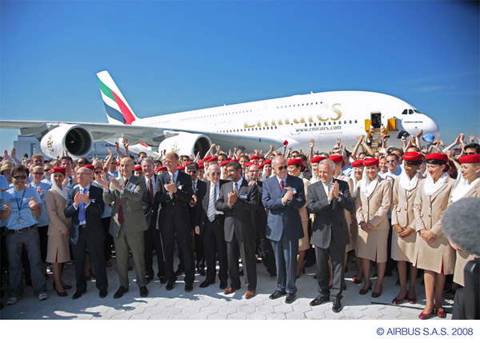
Best practise: emirates airlines
Debt used to invest in fuel alternatives
Customer service awards
Rapid expansion in emerging markets
Recruiting low cost labor
Notes:
Looking at some alternative practices, United Emirates Airlines saved over 500,000 gallons of fuel. This was achieved by utilizing highly efficient engines on their A380 fleet. Recently, Emirates Airlines was awarded having the best “loyalty program” by the Business Traveller Magazine, and was also recognized for having the best “customer service” by the Frequent Travelers Awards. Emirates is planning to capitalize on emerging markets, specifically in India where the company plans to increase the numbers of seats per week to 80,000, up from just over 50,000. As Emirates Airlines is owned by royal family, it has enabled the company has a unique competitive advantage as it doesn’t have to worry about costly labour unions forming.

Slide 9
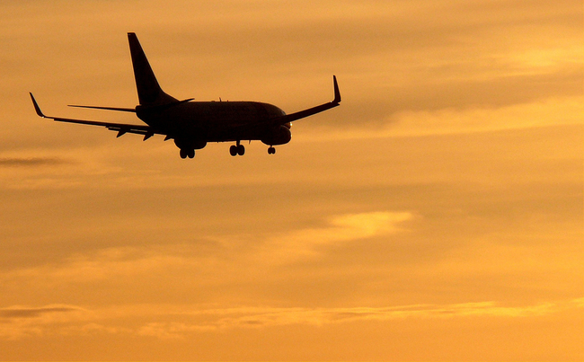
conclusion
Bankruptcy extremely high in the airline industry
Bankruptcy is disruptive to economy and needs to be addressed
Industry should explore new operational models of
Sustainability
Staffing & Compensation
Customer Experience Management
Debt Structuring
Innovation in Airline Industry crucial to future of air travel and the world tourism industry
Notes:
As we have seen today, firms entering Bankruptcy is disproportionately higher in the airline industry than in other major sectors. Though a multitude of factors have created the hostile business environment, several of the most significant are the rising cost of oil, traditional labour power in the industry, and poor customer-experience management leading to low traveler satisfaction.
These bankruptcies cause significant job losses and other ripple effects to the economy, and must be addressed by the industry.
Based on the problems we have presented to you today, Team 4 Consultants has come up with several recommendations for the airline executives to explore. These are:
Looking at new ways of lowering their dependency on traditional fuel. This will affect their revenue by lowering costs and lowering fees for travelers, ensuring greater numbers of flights will be booked. It will also improve their sustainability, therefore providing a point of positive “brand imaging” and avoiding environmental taxes.
Looking at new ways to attract and retain beyond offering non-competitive salaries and benefits.
Placing a higher priority on guest service in order to create brand loyalty and excitement to fly amongst travelers. Make flying a highly personalised, hassle free experience. Look to the hospitality sector to achieve this.
Operating with lower debt ratios to lessen their financial burdens. This could accomplished by flying with smaller fleets, and investing less in specific destinations. Be less “hub” centered would also allow airlines to capitalize on new market opportunities by increasing their operational mobility
A failure to address the circumstances currently plaguing the industry could have dire consequences for global commerce. Innovation and non-conventional thinking in the airline industry will be critical to the future of air travel, as well as the world tourism industry.
Thank you very much for listening to our presentation. We would now like to invite questions from the class.

Slide 10
References
Air Canada’s recent history of strife. (2012, March 23). CBC News. Retrieved from http://www.cbc.ca/news/canada/story/2012/03/23/f-air-canada.html
Awards. (n.d). Emirates. Retrieved from http://www.emirates.com/english/about/awards/awards.aspx
Blodget, H., (2011, November 29). Wait, how can American airlines go bankrupt when 'corporate balance sheets are the strongest in history?’ Business Insider. Retrieved from http://www.businessinsider.com/corporate-balance-sheets-are-the-strongest-in-history 2011-11
Dempsey, P.S. (2012). Airline Bankruptcy: The post-deregulation epidemic. [PowerPoint slides]. Retrieved from http://www.mcgill.ca/files/iasl/aspl613_paul_dempsey_AirlineBankruptcies2012.pdf
Emirates Airlines plans to have 52 per cent more seats for India. (2012). The Economic Times. Retrieved from http://articles.economictimes.indiatimes.com/2012-0904/news/33581986_1_emirates-airlines-indian-airports-indian-economy
Emirates plans three new destinations. (2012, July). Breaking Travel News. Retrieved from http://www.breakingtravelnews.com/news/article/emirates-plans-three-new- destinations/
FOXBusiness, (2011, November 29). History of U.S. airline bankruptcies. Retrieved from http://www.foxbusiness.com/travel/2011/11/29/history-us-airline-bankruptcies/
Francolla, G., and Nelson, A., (2008, February 21). Airlines: A tale of mergers and bankruptcy. CNBC. Retrieved from http://www.cnbc.com/id/23260075/Airlines_A_Tale_of_Mergers_and_Bankruptcy
Glassman, J., (2012, October 16). Once it emerges from bankruptcy, let american airlines stay american. Forbes. Retrieved from http://www.forbes.com/sites/jamesglassman/2012/10/16/once-it-emerges-from-bankruptcy-let-american-airlines-stay-american/
IATA. (2007, July). Unions and wages in the US airline industry. Retrieved from http://www.iata.org/whatwedo/Documents/economics/Hirsch_Unions_Wages.pdf
Jang, B. (2009, July 29). Air Canada lands $1-billion reprieve. The Globe and Mail. Retrieved from http://www.theglobeandmail.com/globe-investor/air-canada-lands-1- billionreprieve/article1235415/
Japan Airlines files for bankruptcy protection. (2010, January 19). BBC. Retrieved from http://news.bbc.co.uk/1/hi/8466997.stm
Long term outlook: Crude oil prices to 2030. (2010, October). Natural Resources Canada. Retrieved from http://www.nrcan.gc.ca/energy/publications/sources/crude/issues-prices/1329
Maxon, T., (2012, October 23). Pilot leadership is fine with delay on american airlines bankruptcy plan. Dallas News. Retrieved from http://www.dallasnews.com/business/airline-industry/20121023-pilot-leadership-is-fine-with-delay-on-american-airlines-bankruptcy-plan.ece
Mnisri. K. (n.d). Emirates Airline: the secret story of a successful company. WordPress. Retrieved from http://leaderswedeserve.wordpress.com/2010/06/21/emirates- airline-the-secret-story-of-a-successful-company/
Namaki, E. (n.d). Emirates Airlines in a league of its own: is this the right strategy?. Business Strategy. Retrieved from http://www.micm-canada.org/Emirates_Apr07.pdf
Nankin, J. & Schmidt, K.K. (2009, April 15). History of U.S. Gov’t Bailouts. ProPublica. Retrieved from http://www.propublica.org/special/government-bailouts
Ringbeck, J., Gautam, A., & Pietsch, T. (2009). Endangered Growth: How the price of oil challenges international travel & tourism growth. (Chapter 1.2)Retrieved from https://members.weforum.org/pdf/ttcr09/Chapter%201.2.pdf
Shankman, S. (2012. November 9). American Airlines only 58% on-time in September. CNN.com. Retrieved from http://www.cnn.com/2012/11/09/travel/airlines-on-time- performance/index.html
The Emirates Group (2012): Annual Report 2011-2012, Emirates Group, Retrieved From: http://content.emirates.com/english/images/EK-AR-10-11_tcm233-750566.pdf
Tolkin, J. (2010). Airline bankruptcy: The determining factors leading to an airline's decline. CMC Senior Theses. Retrieved from http://scholarship.claremont.edu/cmc_theses/88

